Slide 1
Designing efficient processes for
TMF Content when outsourcing clinical trials
Lisa Mulcahy
Mulcahy Consulting, LLC

Slide 2
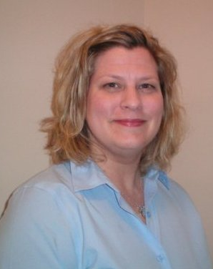
Lisa Mulcahy
Lisa Mulcahy has a 23-year professional career in the Pharmaceutical Research industry. Content and Records Management independent consultant, particularly in the area of the trial master file. She is skilled in the assessment of client's content and records management TMF processes and programs; advising on areas for improvement and proposing future strategic direction ensuring ICH GCP and regulatory compliance.
She has worked closely with numerous large and small companies providing consultative meetings through to providing an in-depth analysis of the current state of affairs, assisting them in the planning their future state of excellence. She works with clients as they embark on the electronic creation, management, and archival of electronic TMF content. Co-leader of the TMF RM Team.
Mulcahyconsulting@comcast.net

Slide 3


The Technology v. the process
Much of the way that the content in Trial Master File is collected, created, and managed is contrary to our normal everyday way of thinking and working.
Consumer rewards cards that connect personal data
with usage and purchase data. We like getting some-
thing for doing nothing.
Phones allow us to do banking transactions;
including photos to deposit checks.
Enroll subjects into clinical studies using
interactive web technology

Slide 4

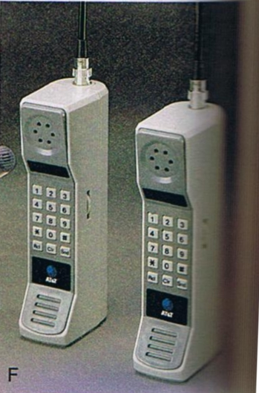

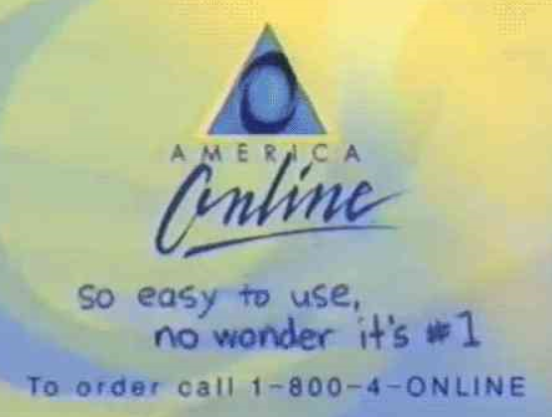
The Technology v. the process
For TMF collection, creation, and management many of us are still working in the…
=

Slide 5

The “old” TMF Paper-based process
Sponsor to CRO or SIte
E
P
P
TMF at CRO
or ISF at Site
P
TMF at CRO
or ISF at Site
END HERE
BEGIN HERE
Up to 11 Steps!

Slide 6
Redesign Process
RETHINK
Rethink
Redesign processes to enable sponsors, CROs, and sites to create and contribute efficiently to the TMF -- without paper or email attachments
Create – Review - Approval – Collect - Submit Distribute - Consume – Acknowledge - Report

Slide 7







How Easy can it be?
Using Technology to its Fullest
SITES
eTMF
PORTAL
SPONSOR
CRO / VENDORS
The technology is already available and will continue to advance
Rethink the Process

Slide 8
So What’s Holding Us back?
OURSELVES!

Slide 9
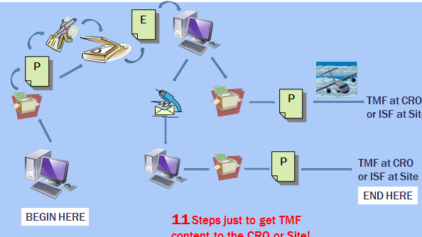
Quick & easy Targets
Eliminate common, costly, and time-consuming pain points
Define the full list of TMF content.
  Use TMF RM to align with industry – why be different?
Evaluate each individually.
  Define purpose, usage/consumption
  Define movement through lifecycle
  Ask whether data entered from templates could replace any document
Use templates to create content directly within eTMF system.
  Auto-populate content
  metadata during creation
BEGIN HERE

Slide 10
Quick & easy Target: Signatures
Reduce internal signature requirements
  Only required per the ICH Guidelines
  Break ingrained habits. Is a signature required to establish accountability?
  Audit trials are functionally equivalent – automatically capture name, date, time
If signatures are absolutely necessary, replace wet-ink with electronic
  Nearly all regulations accept e-signatures
  Quicker document approval process
7

Slide 11
Quick & easy Target: signatures
TMF Content – Signature Required? | TMF Content – Signature Required?
Notification to Investigators of Safety Information | Protocol signature page (Sponsor and Investigator)
Regulatory Submission | Contract with Site
Monitoring Visit Report | Contract with Vendors
Dose Escalation Documentation | Case Report Forms
Trial Management Plan | Regulatory Required Form (ex. Form FDA 1572)
IRB/IEC Approval | Informed Consent
Required by ICH Guidelines
Which ones can be signed electronically?
ALL!

Slide 12
Quick & easy Target: scanning
Stop scanning electronically created documents – manage them electronically
  Cost of inefficient resource utilization v. implementation of an 21CFRP11 compliant repository such as eTMF
If you have to scan, rethink the process…document by document
  Does every document HAVE to be
  scanned?
  Ex. How many people are
  actually using scanned
  site feasibility documentation
  again after collection??
E
P
Notes:
Stop cold the process of scanning electronically created documents that were printed to paper and then scanned to a digital format for most if not all TMF content.
Rethink why this process was instituted at your company and the CRO and if the process is successful, critical, and relevant to today’s business needs.
Ex. How many people are actually accessing the site feasibility documentation. If nobody…don’t scan the document.

Slide 13
Quick & easy Target: Email
Cut use of email and unofficial collaboration sites as document exchange vehicles.
  Establish process to exchange TMF content and electronic signature with CROs, vendors, and investigative sites electronically
  Use cloud-based eTMF with or without validated portal linked to eTMF
P
Notes:
Establish a process for exchange of TMF content with CROs/vendors, and investigative sites through another means such as a validated portal that does not involve email.
Even better if the portal is linked to the eTMF system for seamless exchange, submission, consumption, etc.

Slide 14
Quick & easy Target: shipping
Stop sending paper TMF content by air
  $$$ to pay for transport
  $$$ and time for preparers to prepare
  $$$ and time for receivers to receive
ROI easily calculated if transport
costs are replaced with the “send”
button within an eTMF system or portal
  50 sites X 10 shipments/year
  $20 per shipment= $10K in transport costs
  Easily scalable
P
TMF at CRO
or ISF at Site
Notes:
Eliminate the global distribution of paper TMF content by air.
It takes a lot of money to pay for the transport. It that $ and time for preparers to prepare
It takes $ and time for the receiver to receive
Consider a ROI if this element of distribution of TMF content to your CRO and investigative site is replaced with “send” button.

Slide 15



What could one rethought
Process Look like?
Rethink how a typically paper TMF document with a wet-ink signature component could be created and finalized?
    The Clinical Trial Agreement - critical to timelines
SPONSOR
As-Is Process
CRO
SITES
E
Creation
Negotiation
CRO
SITES
CRO
SPONSOR
P
Wet-ink Signature

Slide 16
How easy can it be?
Using Technology to its Fullest
SITES
eTMF
PORTAL
SPONSOR
CRO / VENDORS
Rethinking processes in which sponsors, CROs, and investigators contribute directly to the TMF

Slide 17
What could ANOTHER rethought
Process Look like?
Rethink TMF content in terms of data sets
  The creation, collection, distribution of TMF content (data) would focus on the information exchanged and not doc creation/collection
  Assessing completeness of data instead of document presence
  Financial status report.
  Easier and significantly less time and $ resource intensive than collecting and tracking forms.
  Consider this… investigators enter financial information in a database through an investigator portal.
extract
  Replace a wet-ink signed form.
Notes:
What if we rethink every piece of TMF content and consider it in terms of a set of data?
The creation, collection, distribution of TMF content (data) would focus on the mechanism and the data exchanged and not the creation/collection of documents.
Instead of assessing presence of content we should be assessing the completeness of data that some TMF content collects.
Ex. Have investigators enter their finance disclosure information as part of a database question (maybe to the CTMS through an investigator portal) instead of on a wet-ink signed form. Truly possible!
Submission of the financial information is extracted as a report and submitted with an NDA/BLA…instead of collecting, tracking forms and extracting data to place on another form.

Slide 18
Critical Steps – Obstacles to Avoid
Company culture cannot be allowed to define the way you rethink your TMF management process. Help your company to break through their old ways of thinking to do some
groundbreaking
process work
1.

Slide 19
Critical Steps – Obstacles to Avoid
Technology cannot provide the process. Technology supports the process
2.

Slide 20
Critical Steps – Obstacles to Avoid
Engage the consumers of the TMF content when you rethink your process– at the sponsor, the CRO, and the investigative site. What do they actually need?
Like the electronic FDF, consumers might only need data…and not a document.
3.
PI/SI
SPONSOR
CRA

Slide 21
In Summary
The technology to collect, create, manage, and exchange efficiently is here and evolving rapidly
We must now rethink the human TMF management processes to best leverage the technology

Slide 22
Thank yoU
To Veeva for the opportunity they have given me to be here with you today
To you for being here and being so engaged
Contact info: MulcahyConsulting@comcast.net

