Slide 1
How to Use the
Commercial Content Kernel in your Life Sciences Taxonomy

Slide 2
Commercial Content Kernel for Life Sciences
Education materials available for customers to use
These slides have been designed for you to use as educational materials for discussions about the Commercial Content Kernel for Life Sciences in your organization.
You will find details on:
  Why there is a new standard for content in Life Sciences?
  What are the benefits for your organization and for the industry more widely?
  What it is?
  How to adopt this standard into your taxonomy?
You can adapt these template slides and share with your colleagues.

Slide 3

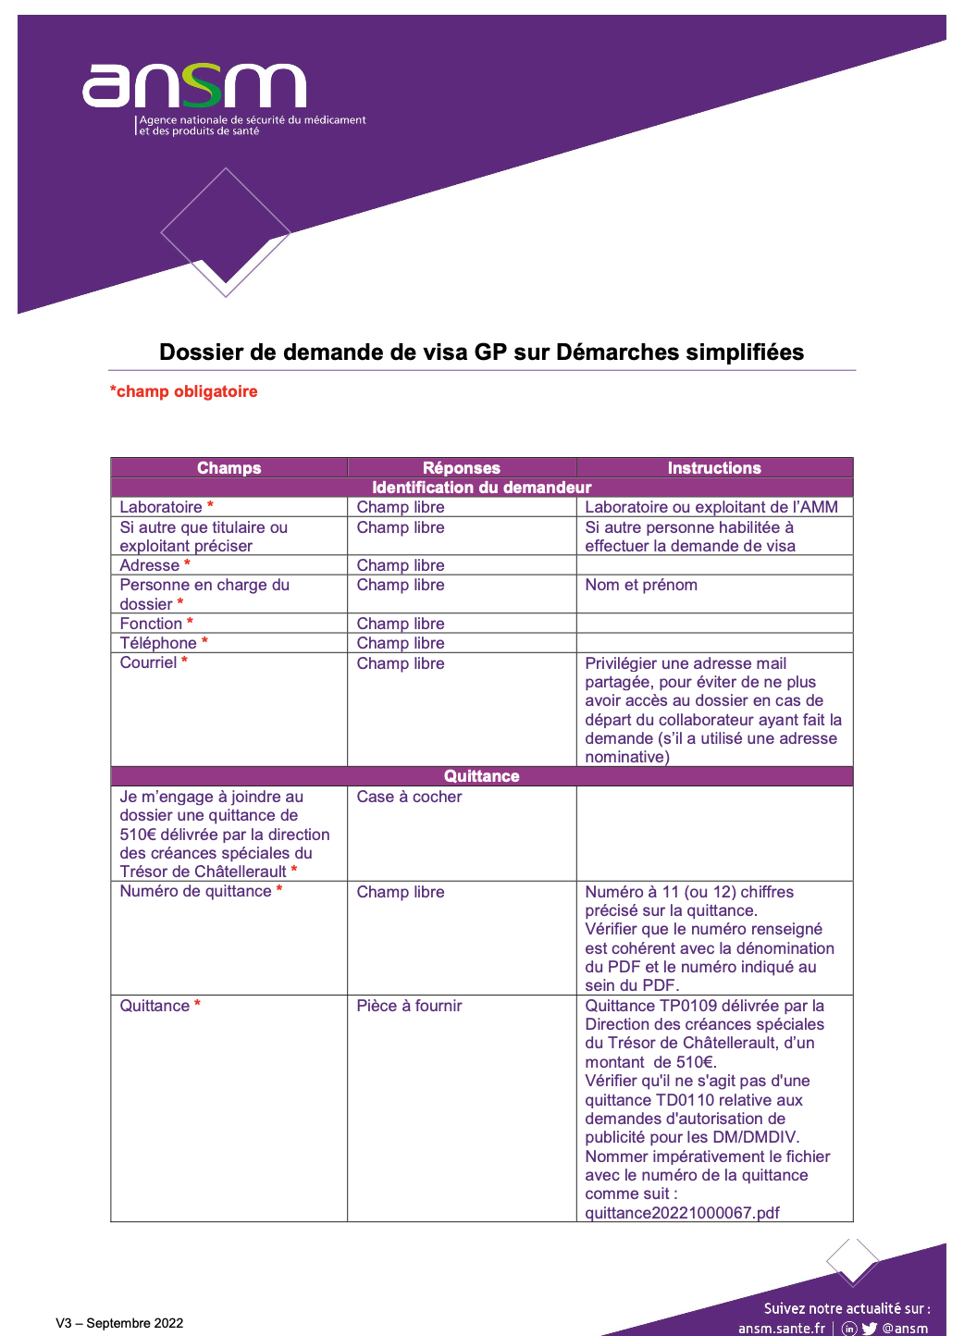
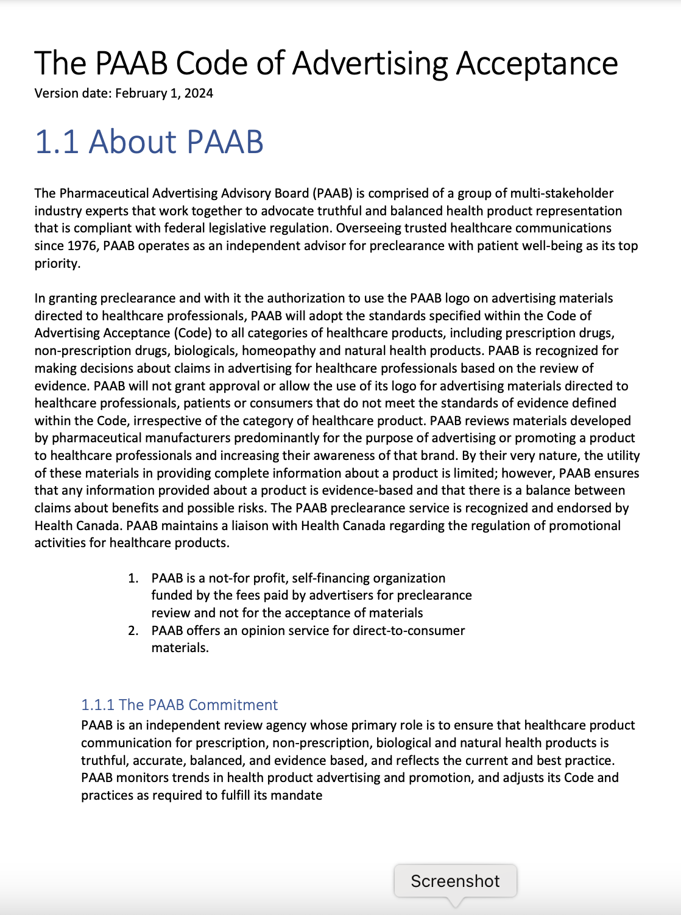

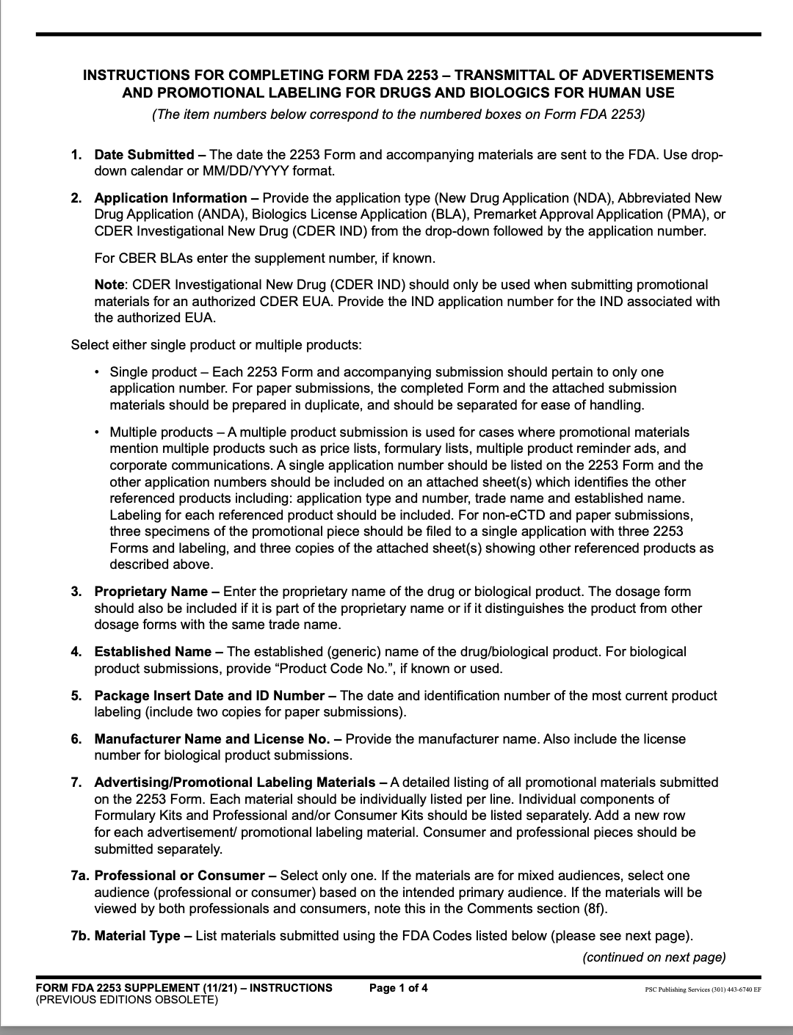

Why Does the Industry Need a Standard for Content?
Inconsistent
300k+
content types maintained by the industry
Duplicative
Hard to understand

Slide 4

Commercial Content Kernel for Life Sciences
A global, industry-specific standard data model created and published by Veeva, used in Vault PromoMats, available to all.
The Commercial Content Kernel (CDA.LS.CC) includes key attributes of taxonomy used by Life Sciences companies to classify commercial content.
The CDA.LS.CC is part of the Common Data Architecture for Life Sciences.
The Common Data Architecture for Life Sciences (CDA.LS, or CDA for short) is an open and freely available standard for software applications, data products, and people to talk to each other with greater consistency and accuracy.
CDA will help create a common understanding within and between organizations that increases speed, efficiency, and quality of data management.
The CDA includes kernels for other key Life Sciences processes such as classification of Healthcare Professionals and Healthcare organizations.

Slide 5
Commercial Content Kernel for Life Sciences
A global, industry-specific standard created and published by Veeva, used in Vault PromoMats, available to all.
Innovation Enabled
by Standardization
Easier for Integrations
Simpler and
Less Expensive
to Maintain
Notes:
The commercial content kernel is a standard data model that is designed to feed into the taxonomy used by Life Sciences companies to classify commercial content.
In pharma and life science companies, commercial content refers to documents used to promote and provide education on products or services. These include marketing materials, sales materials and the documents that substantiate them such as regulatory documents, and clinical trial data.

Slide 6
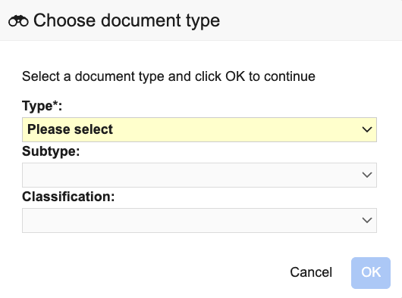
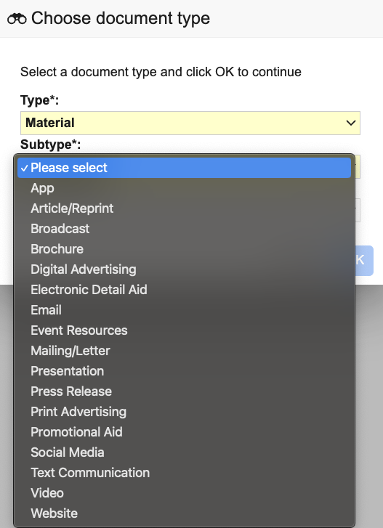
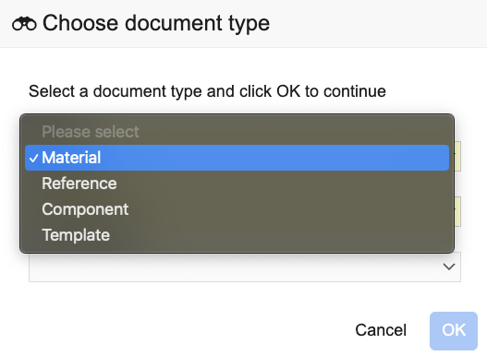
What Does the Commercial Content Kernel Include?
Two attributes: document and document subtypes

Slide 7
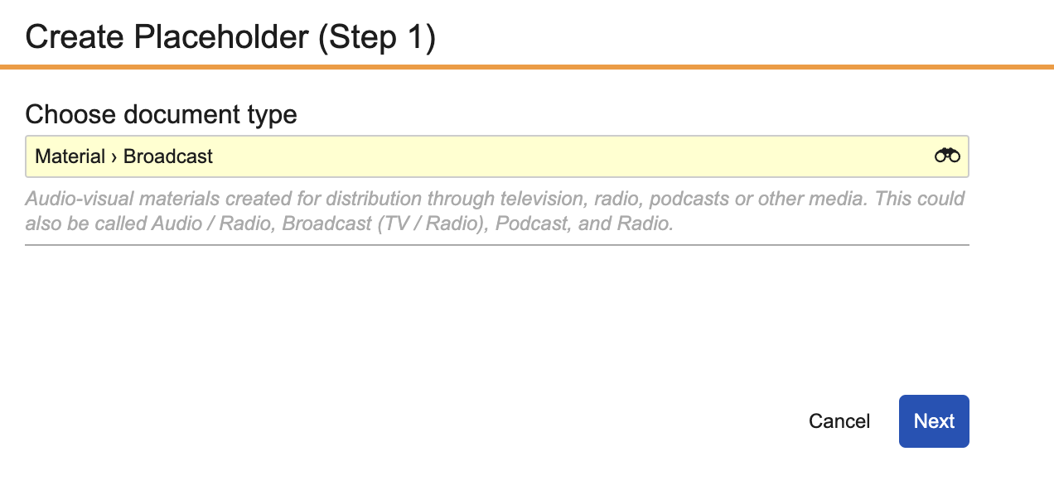
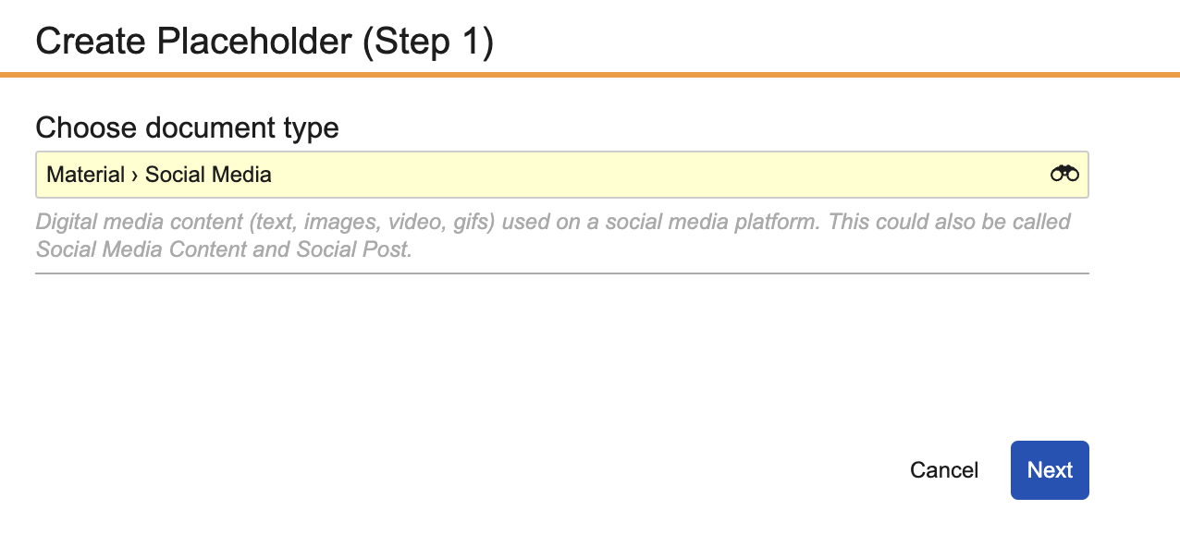
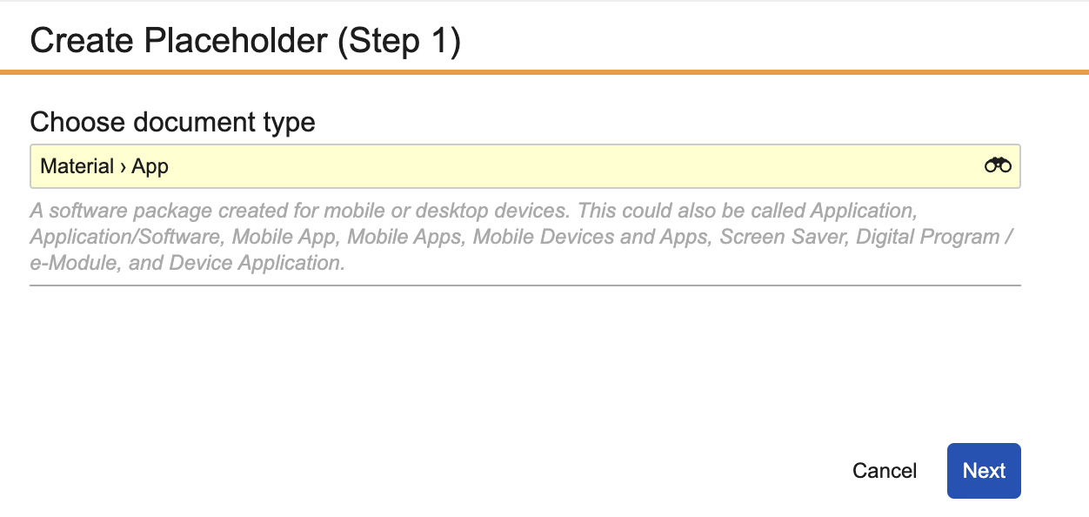
Adopt the Commercial Content Kernel
Available in Vault PromoMats now as inactive
The attributes of the Commercial Content Kernel are available in Vault PromoMats as standard document and document subtypes.
Every document type in the Commercial Content Kernel has a description which includes synonyms which were gathered from the main variations seen across the industry.

Slide 8


Adopt the Commercial Content Kernel
How will the industry adopt? How is Veeva helping?
Available in Vault PromoMats for all customers from August 2024
4-step adoption program to update your taxonomy with the Commercial Content Kernel. A complete methodology for fast and efficient implementation from Veeva Services
Industry Advisory Group established July 2024 to shape and drive industry adoption

Slide 9
4-Step Adoption Program
Update your taxonomy with a complete, fast and efficient program created by Veeva Services
Complete & Pre-built
The Veeva methodology addresses all aspects of configuration, business processes analysis, and customer’s technology ecosystem with clear recommendations for best practices.
Adoption Program
Automation Tools
Specialized tools to automate tasks, and significantly
reduce time and cost.
1. Assessment
2. Configuration
Expert Team
Our dedicated team has extensive experience
implementing all aspects of taxonomy changes.
3. Re-classification
4. End-user enablement
Notes:
Ani

Slide 10
4-Step Adoption Program
A complete, fast and efficient implementation with Veeva Services
ASSESSMENT
CONFIGURATION
RECLASSIFICATION
END-USER ENABLEMENT
Expert Led Analysis
Configuration and business process analyses, including mapping and impact assessments.
Document types
Industry Standard:
Taxonomy configuration
Core Vault
Data Driven Approach: Core Vault re-configuration based
on configuration analysis
Integrations
Connected: Reconfiguring integrations to work with new standards
(if applicable)
Complete
Reclassifying existing content to the standard document types
Equipped for success
Leading change management activities, including communication, education and analytics to ensure a seamless shift
2–6 months
Notes:
The implementation timeline typically ranges from two months to six months and is always right-sized for each customer through scoping.
The time required can vary based on Vault complexity, integrations, and available content.

Slide 11
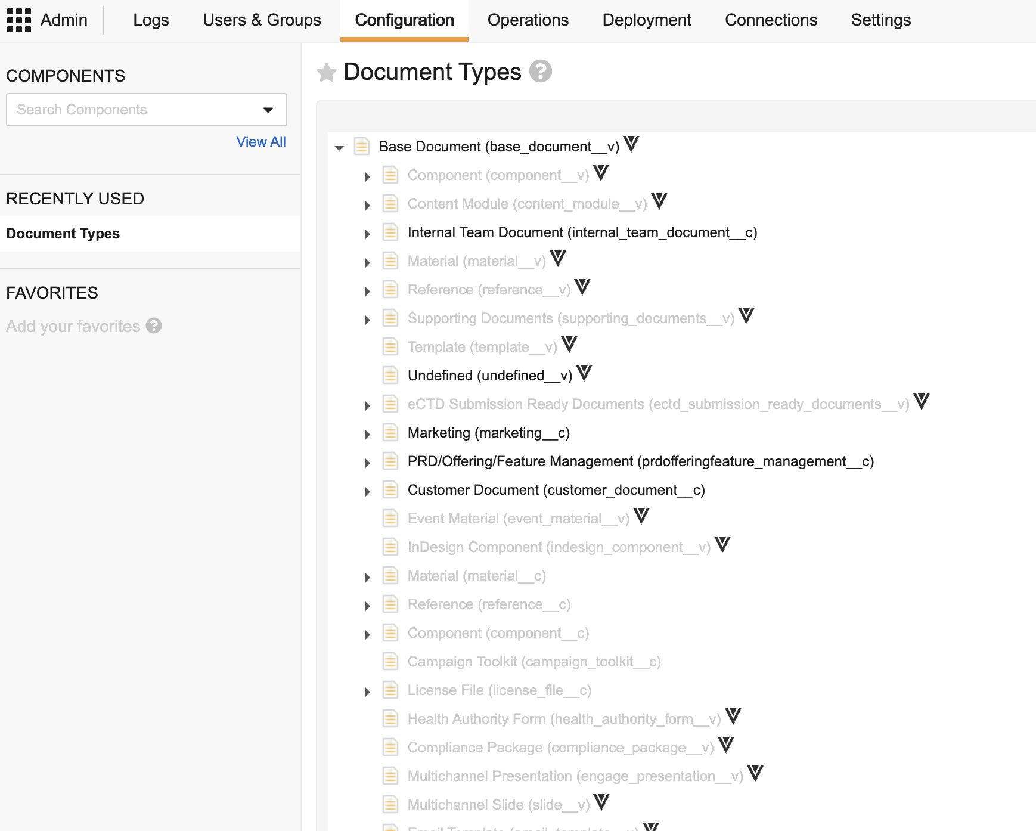
Your Current Taxonomy in Vault PromoMats
Unlock insights by engaging your Vault Admins in a quick taxonomy check-up
Do a quick assessment of your taxonomy complexity and potential for standardization using the CDA.LS.CC by looking at:
Number of Document Types
Number of Subtypes
Number of Classifications
Are clear descriptions available for all Types, Subtypes, and Classifications?
CONTACT YOUR VEEVA TEAM TO START A DETAILED ASSESSMENT OF YOUR VAULT PROMOMATS
Vault Admins can see the complexity of current taxonomy in your configuration in the “Document Types” area in Admin.

Slide 12
Is This Different to the Taxonomy Launched in August 2024?
You can use this information to explain why commercial content taxonomy is now referred to as the Commercial Content Kernel
The industry recognized the value and importance of the Commercial Content Taxonomy for Life Sciences, supported by our Industry Advisory group
The Commercial Content Taxonomy is now being added as a Commercial Content Kernel within the Common Data Architecture
This will formalize the standard and start the process of making this common language available across Veeva products and the industry
The Commercial Content Kernel includes the two attributes, document types and subtypes, which are already included as standard in Vault PromoMats
The Veeva Services team have built a 4-step adoption program to help Life Science companies incorporate this standard into their taxonomy.

Slide 13
For More Information, We Are Here to Help
veeva.com
More information, including a white paper and the Commercial Content Kernel
Your Veeva Account Partner
How to adopt the Commercial Content Kernel in your organization

